Slide 1
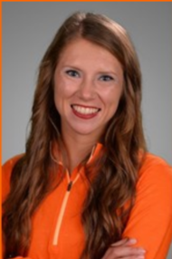
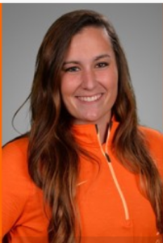
Gilman City Softball Camp
(Oct. 20th, 21ST)
Outfielder
Jamie Lowrie-Overton
Learn from 2018 Oklahoma State University (OSU) Softball Graduates, Jamie Lowrie-Overton and Emmie Robertson!!!
Starting Pitcher
Emmie Robertson
Camp Will Include:
SATURDAY MORNING (8:30-11:00) – HIGH SCHOOL AND JR. HIGH PITCHERS/CATCHERS (Pitchers supply their own catchers) : CATCHING DRILLS AND PITCHING LESSONS
SATURDAY AFTERNOON (12:00-6:00) – HIGH
SCHOOL/JR HIGH HITTING EXERCISES,
FIELDING EXERCISES, SPEED AND AGILITY
TRAINING AND HITTING COMPETITION
HELP THE BALL ASSOCIATION RAISE MONEY
FOR A NEW SCOREBOARD!!!
SUNDAY MORNING (8:30-11:00) – ELEMENTARY
PITCHERS/CATCHERS (pitchers supply their own
catchers) : CATCHING DRILLS AND PITCHING
LESSONS
SUNDAY AFTERNOON (12:00-6:00) - HITTING
EXERCISES, FIELDING EXERCISES, SPEED AND
AGILITY TRAINING AND HITTING COMPETITION
PITCHING/CATCHING CAMP- $15.00
HITTING/FIELDING CAMP - $35.00
4th GRADE THROUGH HIGH SCHOOL STUDENTS MAY ATTEND. REGISTRATION FEES AND STUDENTS SHIRT SIZES MUST BE SUBMITTED BY Friday, September 21st.
FOR THOSE THAT ATTEND THE PITCHING CAMP, SHIRTS WILL NOT BE PROVIDED UNLESS THE STUDENT ATTENDS THE HITTING/
FIELDING CAMP AS WELL. LUNCH WILL NOT BE
PROVIDED. WATER WILL BE PROVIDED AT
NO ADDITIONAL CHARGE.
SUBMIT REGISTRATION FEES AND SHIRT SIZES TO
203 Broadway Avenue, Gilman City MO, 64642
MAKE CHECKS PAYABLE TO GILMAN CITY BALL ASSOCIATION
FOR MORE INFORMATION CALL OR TEXT JESSE CRUMP AT 660-373-0285

