Slide 1
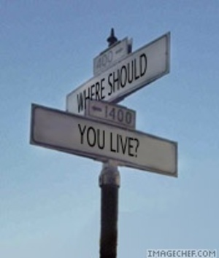
Choosing A Place To Live

Slide 2
Checking Out a Home
You are looking for a home. You think you may have found one.
When should you check it out????

Slide 3
Various times of the day and night.
Why
Neighborhoods are different at different times of the day of night.

Slide 4
What might be different?
Sounds
Smells
Traffic
Light
The number of people
The kind of people

Slide 5
Sounds
Noisy
Quiet
Cars
Factory
Airplanes
Sirens
Kids
Anything that might bother you

Slide 6
Smells
Pollution from manufacturing that blows in
Cooking from nearby restaurants
Trash

Slide 7
Traffic
People coming and going to work
Kids
Deliveries
Trucks etc cutting through the neighborhood to haul supplies somewhere
Will it be safe for your kids and pets

Slide 8
Light
Check it out at night
Is it well lit?
Will you feel safe?
Is it too much light – preventing you from sleeping

Slide 9
Number of People
Is there always someone in the neighborhood
Are there too many people so that it is never quiet
What kind of people are there – old, young noisy kids, kids to play with your kids, gangs, parties that keep you awake???
Do you feel safe around these people?

Slide 10
Check it Out
Go at different times of the day and on different days (weekdays as opposed to weekends).
What goes on in the morning, afternoon, evening, and at night may not be the same thing.
What appears to be a quiet neighborhood in the day, may be loud at night.
What may be nice in the evening or weekend, may be a smelly neighborhood as pollution and smells float in from nearby factories.

Slide 11
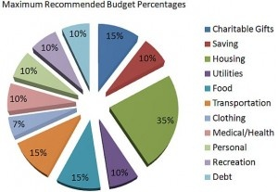
Dave Ramsey Recommendations

