Slide 1
Checking Account & Debit Card Simulation
Understanding Checking Accounts and Debit Card Transactions

Slide 2
What is a Checking Account?
Common financial service used by many consumers
Funds are easily accessed
  Check
  ATM (automated teller machine)
  Debit card
  Telephone
  Internet
Services and fees vary depending upon the financial institution

Slide 3
Why Do People Use Checking Accounts?
Reduces the need to carry large amounts of cash
Convenience – useful for paying bills
Spending Plan Tool
  Keeps a record of where money is spent
Safety – using checks is safer than carrying cash

Slide 4
What is a Check?
Used at the time of purchase as the form of payment
Piece of paper pre-printed with the account holder’s:
  Name
  Address
  Financial institution
  Identification numbers

Slide 5
Bouncing a Check
Check written for an amount over the current balance held in the account
  ‘Bounces’ due to insufficient funds, or not enough money in the account to cover the check written
A fee will be charged to the account holder
Harm future opportunities for credit

Slide 6
Other Checking Components
Checking Account Register
  Place to immediately record all monetary transactions for a checking account
    Written checks, ATM withdrawals, debit card purchases, deposits and additional bank fees
Checkbook
  Contains the checks and the register to track monetary transactions

Slide 7
ATM
Automated teller machine, or a cash machine
Can be used to withdraw cash and make deposits
Additional fees may be assessed if the ATM used is not provided by the financial institution sponsoring the card

Slide 8
Debit Card
Plastic card that looks like a credit card
Electronically connected to a bank account
Money is automatically taken from the bank account when purchases are made
Requires a PIN (personal identification number)
  Confirms the user is authorized to access the account

Slide 9
To Use A Debit Card
Swipe it through the store machine or put into an ATM
Enter the PIN
Complete transaction

Slide 10
Pros and Cons - Debit Cards
Pros Cons
Convenient
Small
Can be used like a credit card
Allows a person to carry less cash
Does not allow overspending
Can lose track of balance if transactions are not written down
Opens checking account up to credit fraud
Others can gain access to the account if the card is lost and PIN is known

Slide 11
Endorsing a Check
Endorsement
  Signature on the back of a check to approve it to be deposited or cashed
  A check must be endorsed to be deposited
Three types
  Blank
  Restrictive
  Special

Slide 12
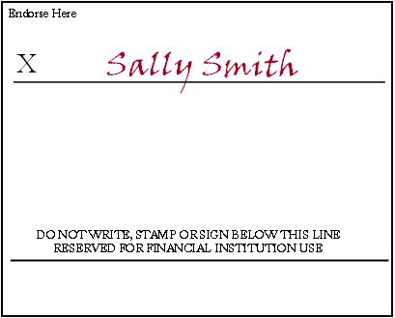
Blank Endorsement
Receiver of the check signs his/her name
Anyone can cash or deposit the check after has been signed

Slide 13
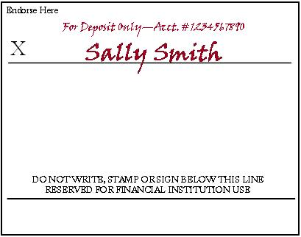
Restrictive Endorsement
More secure than blank endorsement
Receiver writes “for deposit only” and account number above his/her signature
  Allows the check to only be deposited

Slide 14
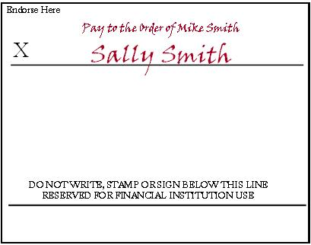
Special Endorsement
Receiver signs and writes “pay to the order of (fill in person’s name)”
Allows the check to be transferred to a second party
  Also known as a two-party check

Slide 15
Worksheet Answers
Blank
Restrictive
Endorse Here
Endorse Here
For Deposit Only—Acct. # 987654321
Student’s Signature
X
Student’s Signature
X
Special
Endorse Here
Pay to the Order of Jonathon Smith
Student’s Signature
X

Slide 16
Making a Deposit
Deposit slip
  Contains the account holder’s account number and allows money (cash or check) to be deposited into the correct account
  Located in the back of the checkbook
Complete a deposit slip to make a deposit
Deposited amount must be recorded in the checking account register to keep the balance current
Deposits can be made at an ATM or with a bank teller

Slide 17
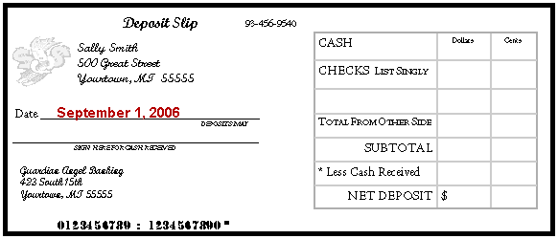
Completing a Deposit Slip
Date
  The date the deposit is being made

Slide 18
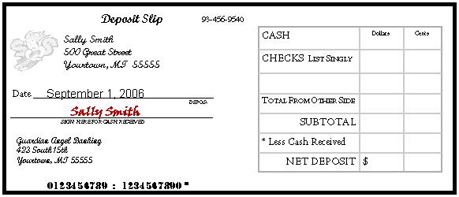
Completing a Deposit Slip
Signature Line
  Sign this line to receive cash back

Slide 19
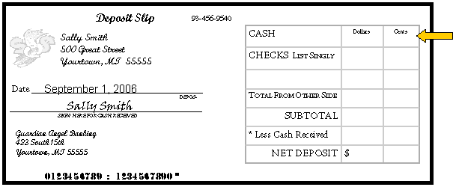
Completing a Deposit Slip
Cash
  The total amount of cash being deposited

Slide 20
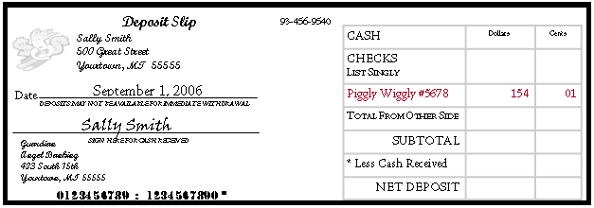
Completing a Deposit Slip
Checks
  List each check individually
    Identify each check on the deposit slip by abbreviating the name of the check writer

Slide 21
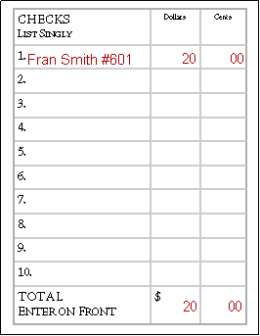
Completing a Deposit Slip
Checks
  If more checks are being deposited than number of spaces on the front, use the back
  List each check
  Add the total, enter it on the front

Slide 22
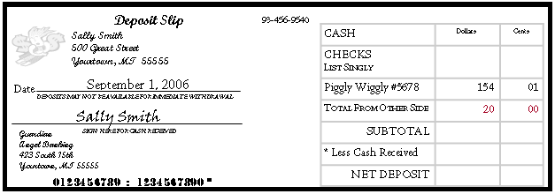
Completing a Deposit Slip
Total from Other Side
  The total amount from all checks listed on the back

Slide 23
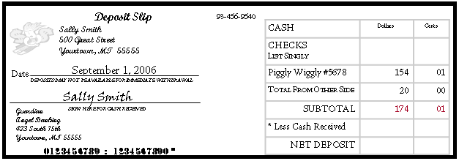
Completing a Deposit Slip
Subtotal
  The total amount of cash and checks

Slide 24
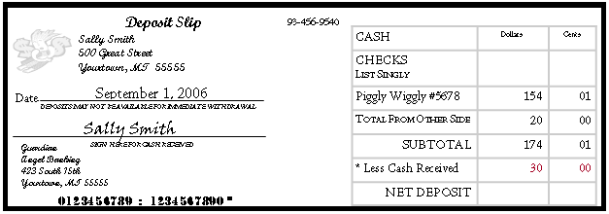
Completing a Deposit Slip
Less Cash Received
  The amount of cash back being received
  This amount is not deposited into account

Slide 25
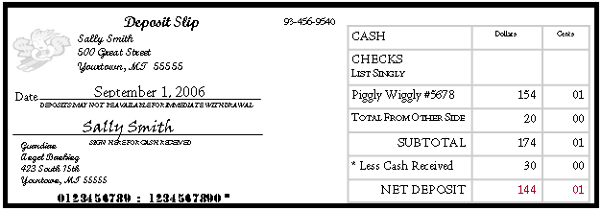
Completing a Deposit Slip
Net Deposit
  The amount being deposited into the account
  To calculate the amount, subtract the cash received from the subtotal

Slide 26
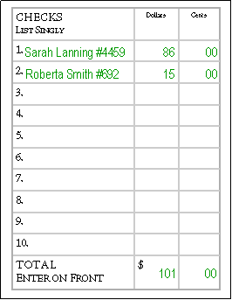
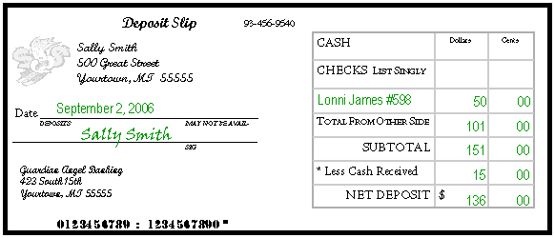
Worksheet Answer

Slide 27
Writing a Check
To pay for items using a checking account
  A check is given as a form of payment
  Must be completed and given to the person or business
Pre-printed items on a check
  Name and address of account holder
  Name and address of financial institution
  Check number
  Identification numbers (account, routing)

Slide 28
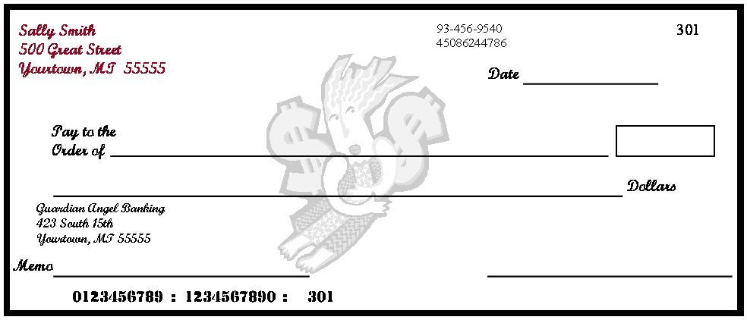
Writing a Check
Personal Information
  Account holder’s name and address
  May include a phone number, not required
  DO NOT list a social security number for safety reasons

Slide 29
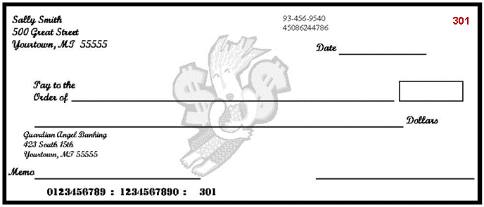
Writing a Check
Check Number
  Numbers used to identify checks
  Printed chronologically

Slide 30
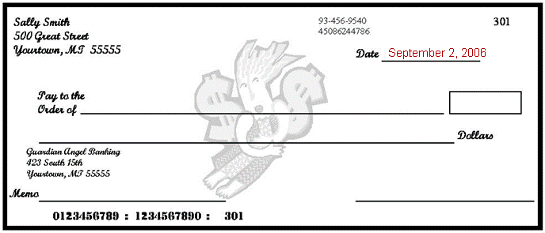
Writing a Check
Date
  The date the check is written

Slide 31
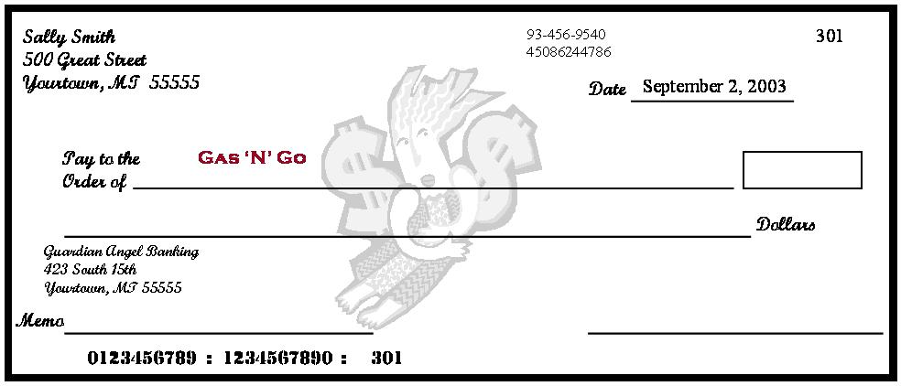
Writing a Check
Pay to the Order of
  The name of the person or business to whom the check is being written

Slide 32
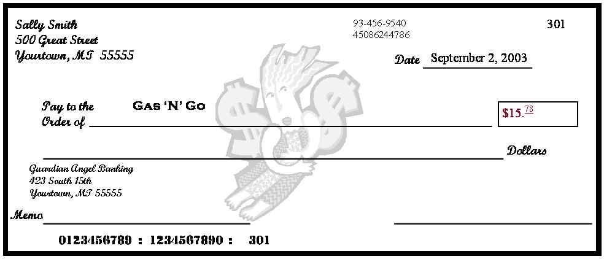
Writing a Check
Amount of the Check in Numerals
  The amount of the check written numerically in the box
  Write the cents smaller and underline
  Write the numbers directly next the dollar sign to prevent someone else from adding numbers to change the amount

Slide 33
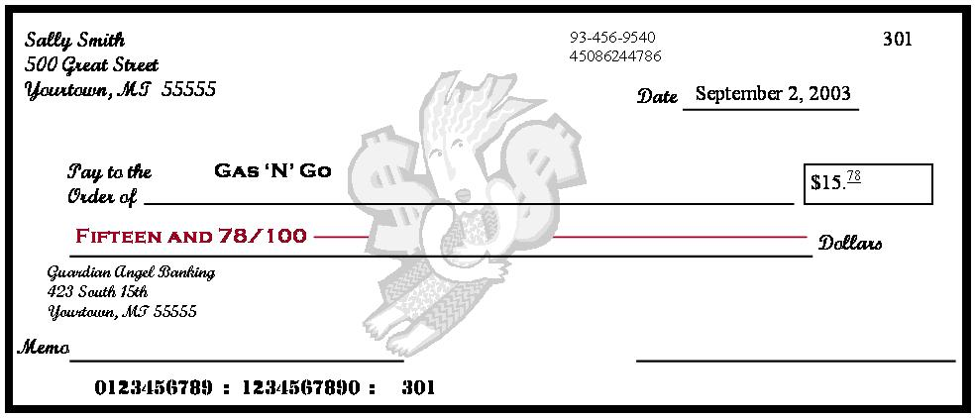
Writing a Check
Amount of the Check in Words
  The amount of the check written in words on the second line
  Start at the far left of the line, write the amount in words, followed by ‘and’, and the amount of cents over 100; draw a line from the end of the words to the word ‘dollars’

Slide 34
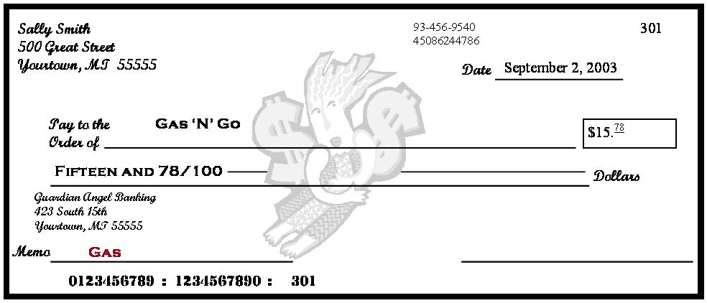
Writing a Check
Memo
  Space used to identify the reason for writing a check; optional
  Good place to write information requested by a company when paying a bill, generally the account number

Slide 35
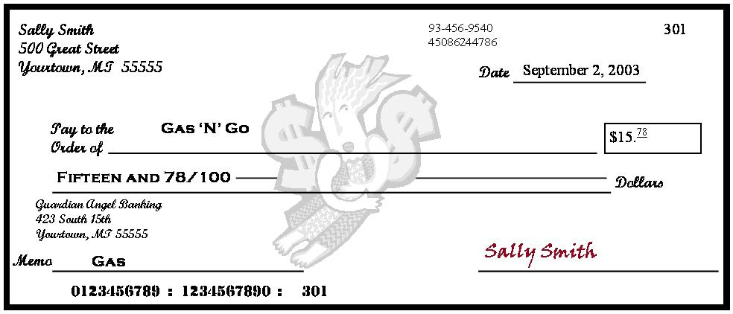
Writing a Check
Signature
  The account holder’s signature agreeing to the transaction

Slide 36
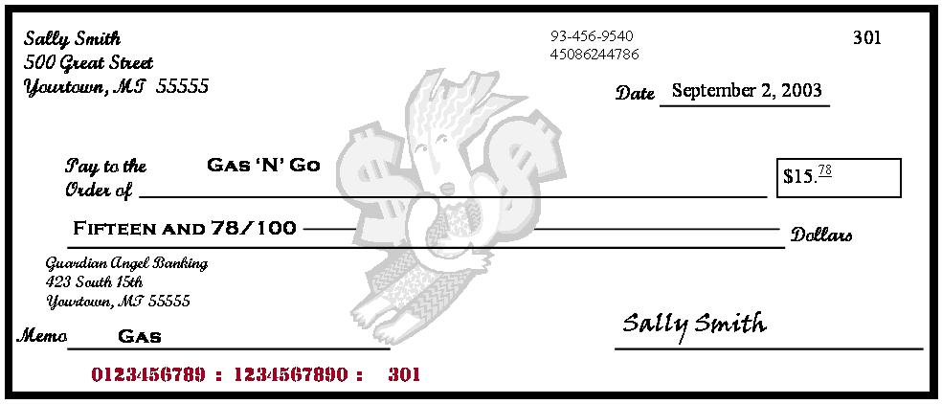
Writing a Check
Identification Numbers
  First - routing numbers to identify the account’s financial institution
  Second - account number
  Third - check number

Slide 37
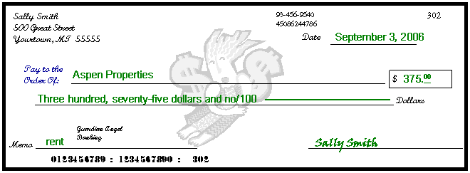
Worksheet Answers

Slide 38
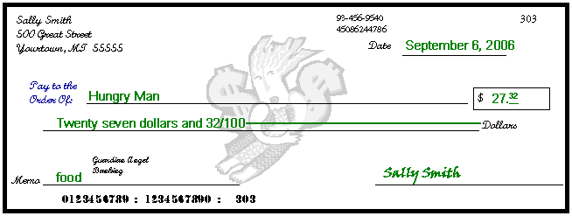
Worksheet Answers

Slide 39
Check 21 and Overdraft
Check Clearing for the 21st Century Act (Check 21)
  When a check is written, the money is automatically withdrawn from a bank account
  Makes “bouncing checks” difficult
Overdraft protection from a depository institution
  Consumers may choose to allow their depository institution to accept transactions which will exceed their available balance and be charged a $20-$30 transaction fee.
  Or, a consumer may choose to allow a transaction to be declined if there are not sufficient funds.

Slide 40
Debit Card
Account Number—Links all purchases made with the card to a designated bank account
Expiration Date— The debit card is valid and may be used until this date
Cardholder’s Name— The cardholder’s full name is written out and displayed.
Magnetic Strip— When the debit card is swiped, the magnetic strip automatically withdraws funds from the cardholder’s account.

Slide 41
Debit Card
Authorized Signature— Sign in the signature box on the back of the debit card to authorize payments
  Should also write, “See ID” in the signature box
  Ensures the person using the card is authorized to do so
Verification Number—This three digit code is located on the back of the card in the signature area
  Help ensure the card is in the cardholder’s possession when making purchases
  Prevents unauthorized use

Slide 42
Checking Account Register
Place to record all monetary transactions for a checking account
    Deposits, checks, ATM use, debit card purchases, additional bank fees
Used to keep a running balance of the account
Remember
  Record every transaction!

Slide 43
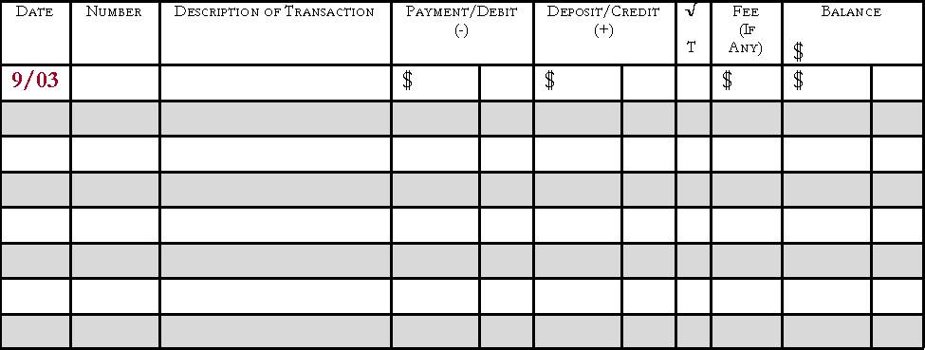
Check Register
Date
  The date the check was written or transaction was made

Slide 44
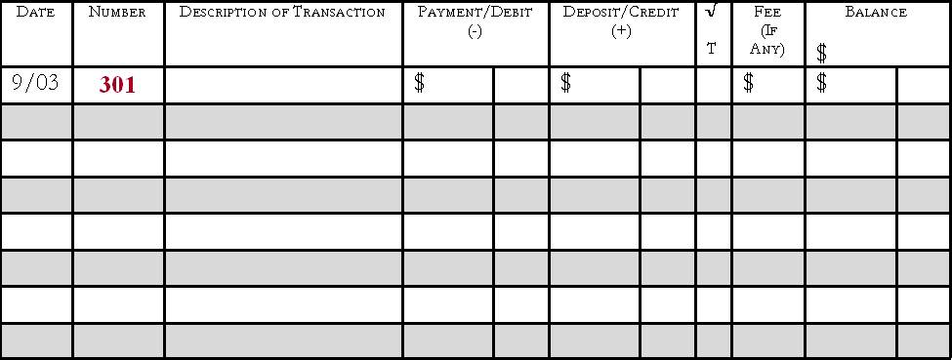
Check Register
Number
  The number of the written check; if a debit card or ATM was used, write DC or ATM

Slide 45
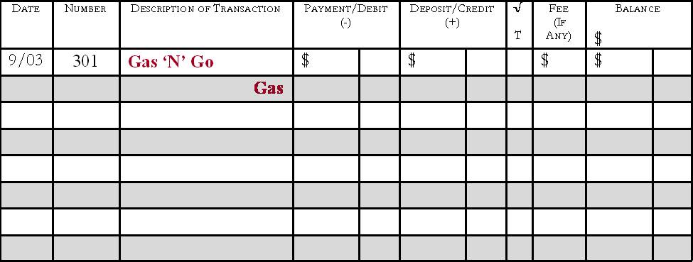
Check Register
Description of Transaction
  The person/business the check was written to or where the debit card was used
  Gray line can be used to write the memo

Slide 46
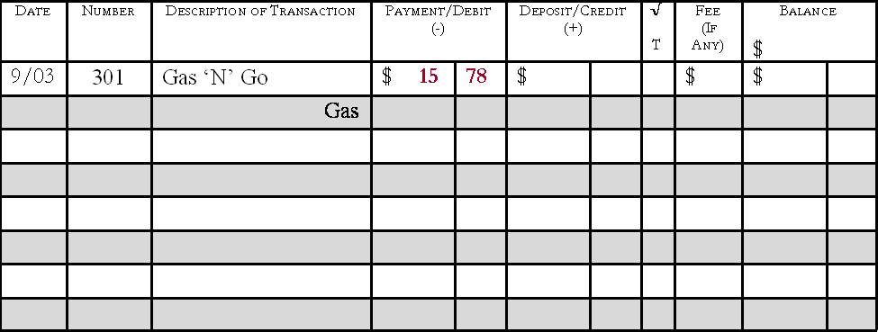
Check Register
Payment/Debit(-)
  Amount of the transaction
  Deducted from the balance

Slide 47
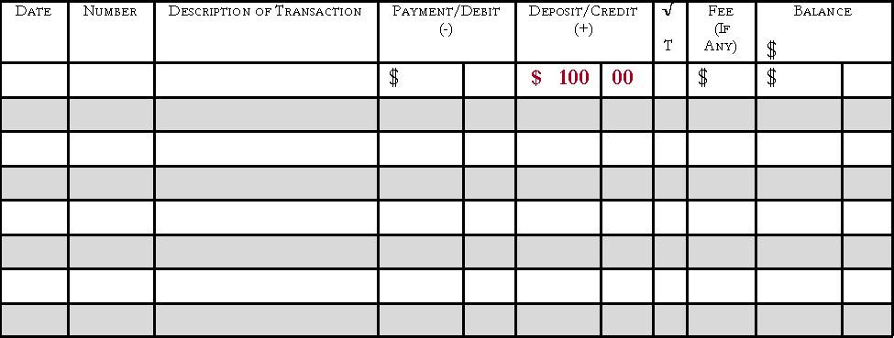
Check Register
Deposit/Credit(+)
  Amount of the transaction
  Added to the balance

Slide 48
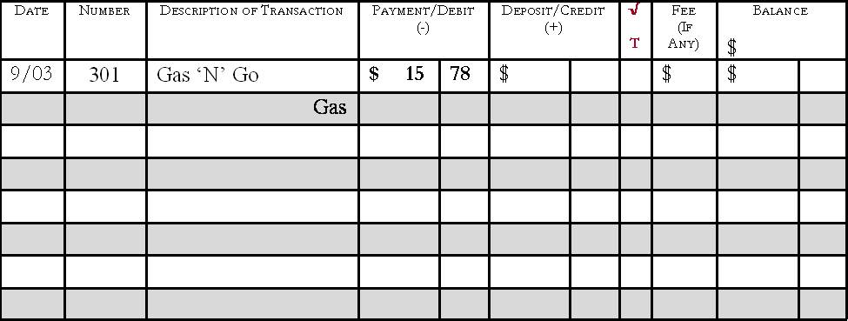
Check Register
√ T
  A box used to track whether the check has cleared on the monthly bank statement when reconciling at the end of each month

Slide 49
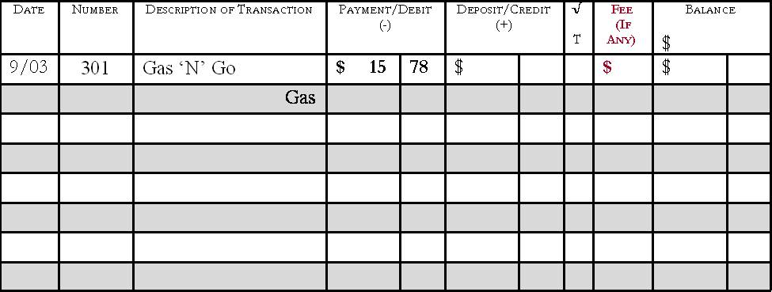
Check Register
Fee (if any)
  Any extra fees charged to the account
  Listed on the bank statement

Slide 50
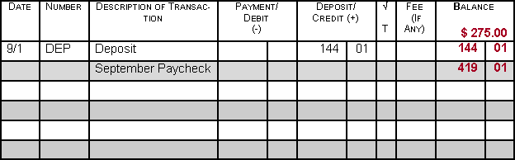
Check Register
Balance
  The running total of the checking account
  Calculated by adding or subtracting each transaction
  Keep this updated

Slide 51
Monthly Bank Statement
Lists each monetary transaction and the current account balance for a specified time period
Includes:
  Dates
  Identification for each transaction (number or type, date, amount)
  Transaction amounts for withdrawals and/or deposits
  Interest earned (if applicable)
  Fees or charges (if applicable)

Slide 52
Monthly Bank Statement
Lists each transaction and current account balance
  Deposits
  Checks
  Debit Card transactions
  ATM transactions
  Additional fees

Slide 53
Reconciling a Checking Account
Reconcile
  Balance the checkbook register each month to the balance shown on the statement
Do this every month to ensure the correct balance in the checkbook
  Knowing the correct balance can help to avoid bouncing checks

Slide 54
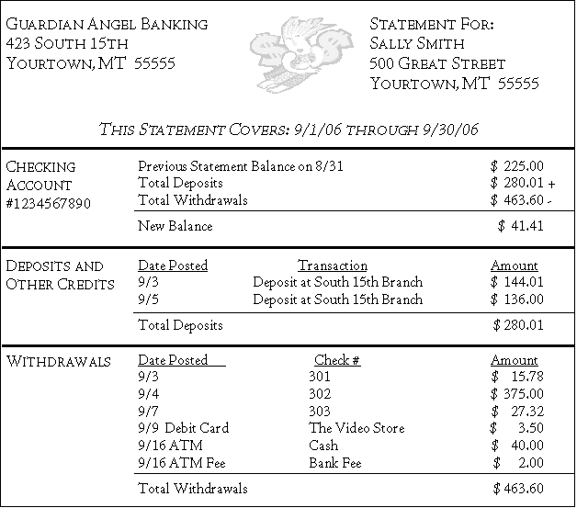
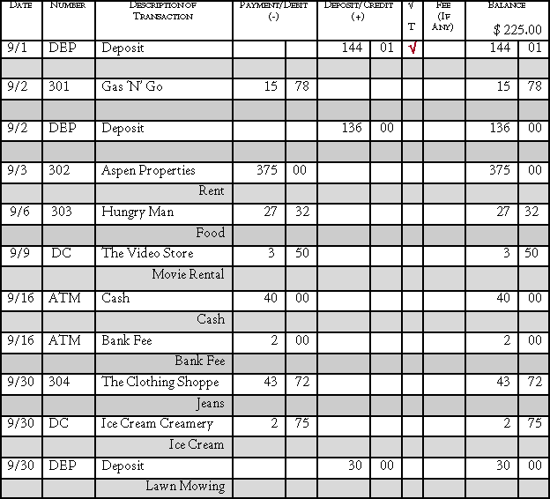
Steps for Reconciling
View the monthly bank statement and check register

Slide 55
Place a check mark in the √ T column for all transactions that have been cleared and are shown on the bank statement
√
√
√
√
√
√
√

Slide 56

Determine the current account balance from the bank statement

Slide 57
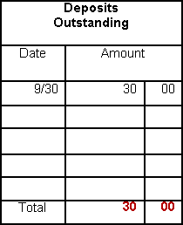
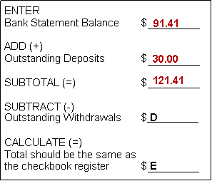
Add any outstanding deposits – transactions that have not cleared the bank
Calculate the Subtotal

Slide 58
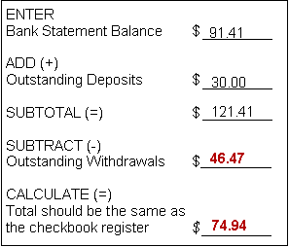
Subtract any outstanding withdrawals and calculate
  Compare the total with the checkbook register. If the totals are different, double check the math and make sure all service fees and bank charges are recorded in the check register.

Slide 59
Checking Account Safety
If a checkbook, ATM, and/or debit card becomes lost or stolen
  Immediately report it to the financial institution
  File a report with the police
Reported lost/stolen checkbook:
  Financial institutions generally do not hold the account holder liable for any fraudulent charges

Slide 60
Safety continued
Reported lost/stolen ATM/debit card:
  Within 2 business days
    Cardholder is only liable for $50.00
  Longer than 2 business days
    Could be liable for up to $500.00
  Varies depending upon the financial institution
    May not charge the account holder anything if the correct steps were taken to report the lost/stolen card

Slide 61
Questions?

