Slide 1
minerals

Slide 2

1. Can our bodies produce minerals?
NO! We have to get them
through eating food that
contains them!
Most minerals become part of the body, i.e. bones and teeth.
Others are used to make
substances that the body needs.

Slide 3
About minerals
Minerals do not provide energy but are essential because they regulate body chemistry and body functions.
There are about 60 different minerals that make up about 4% of our body.

Slide 4

2. What are macro minerals?
Minerals needed in larger quantities in our bodies:
Sodium
Calcium
Phosphorus
Potassium
Magnesium

Slide 5
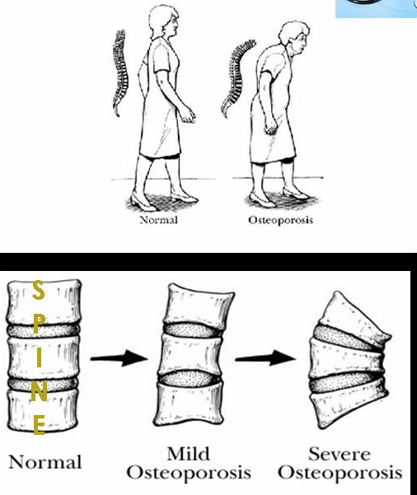
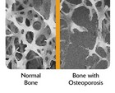
Calcium Deficiency
Osteoporosis

Slide 6
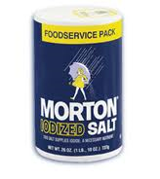
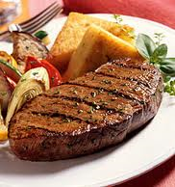


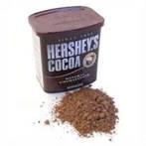
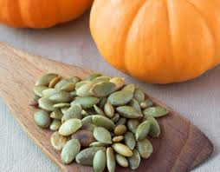
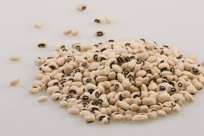
3. What are trace minerals?
Minerals needed in less amounts in the body, but just as important as macro minerals in function.
Iron
Iodine
Fluoride
Zinc
Copper

Slide 7
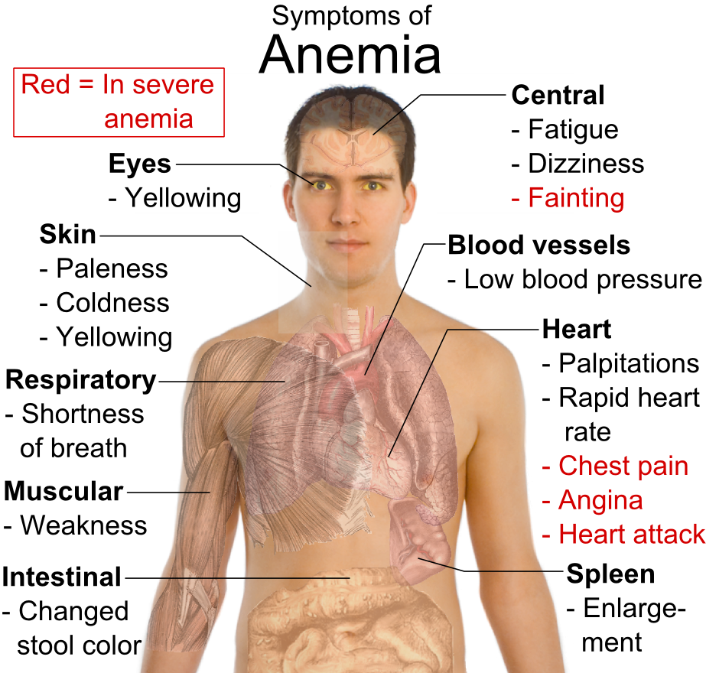
Iron Deficiency

Slide 8
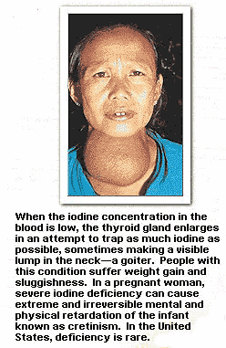
Iodine Deficiency
Goiter: visible lump in the neck

Slide 9

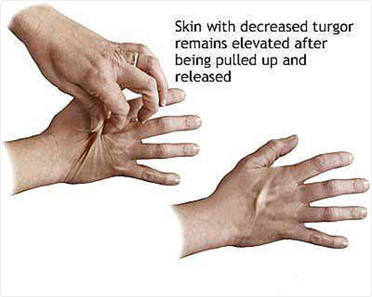
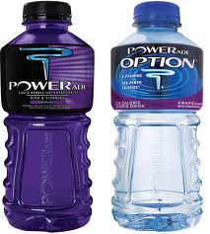
Electrolytes
Minerals that help maintain the fluid balance in the body, help maintain the heartbeat, help muscle and nerve action.
Electrolytes easily become imbalanced in cases of dehydration, illness and diarrhea.

Slide 10
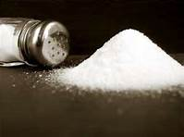
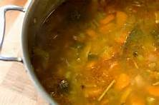
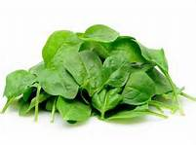
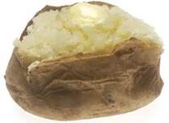

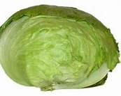

The electrolyte minerals
Sodium
Potassium
Chloride

Slide 11
Other minerals & their functions
Potassium – regulates the heartbeat
Sodium – maintains balance for water flow in and out of cells
Zinc – part of an enzyme involved in –acid-base balance, liver functions, digestion, and bone maintenance
Fluorine – produced tooth structure that resists acids, prevents tooth decay
Copper – used in breathing, energy release, productions f red blood cells

Slide 12


Mineral Food Sources
Calcium - milk and milk products, egg yolks,
green leafy vegetables, fish eaten with bones
Phosphorus - milk and milk products, fish, poultry, legumes, whole grain breads and cereals
Magnesium - organ meats, whole grain cereals and breads, nuts, legumes, green leafy vegetables, milk and egg yolks
Sodium - found in most foods, table salt,
baking powder, baking soda, cheese, processed
foods
Chlorine - found in most foods, table salt

Slide 13

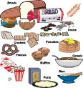
Mineral Food Sources
Potassium - fish, meat, bananas, citrus
fruit and milk
Iodine (trace mineral) - saltwater seafood,
iodized salt, most foods of animal origin
Zinc (trace mineral) - seafood, meat,
eggs, poultry, milk, and whole grains
Iron (trace mineral) - liver, kidney, heart,
lean meats, egg yolks, nuts, dried fruits,
whole grain and enriched breads and cereals,
legumes

Slide 14

More about minerals
They do not improve athletic performance.
Most people will not need a supplement if they eat properly.
Not all supplements are regulated by the FDA so they may not be safe.
Popeye ate spinach because
it is a good source of iron.

