Slide 1
Chpt 1 Learning About Children,
Section 1, p21
Making a Difference in Children’s Lives

Slide 2
Objectives:
Summarize the benefits of studying children
Explain how learning about typical behaviors can help you better understand children.
Describe how childhood today differs from childhood in the past.
Key Terms
Typical behaviors
Caregivers

Slide 3
Read: Making a Difference in Children’s Lives p21
Why do you want to learn about children?
Why is understanding yourself, helpful in understanding children?

Slide 4
Your impact on children
No matter whether you are around children a lot or a little you may be impacting or influencing them by your actions.
Brainstorm –how do you impact children?

Slide 5
Your Impact
Bottom line, be a good example.

Slide 6
Benefits of Studying Children p21
Understand them better
Understand yourself better
Best way to learn about children is to be involved with them.
You will:
Learn why children feel, think, and act the way they do.
There are typical behaviors that are common at each stage of childhood. Understanding these will help you respond better.
Ex: it is typical for 2 yr olds to play beside each other but not with each other.

Slide 7
Benefits of Studying Children p21
Discover caregiver’s
Who are caregivers?
Caregivers provide more than just food, shelter, and clothing
What else do they provide?

Slide 8
Benefits of Studying Children p21
Cont.
Enjoy children more
It’s somewhat like the fear of the unknown. If you know what you are doing, you are more comfortable and confident so you can enjoy what you do. Caring for children can be scary if you aren’t prepared.,
Learn about career opportunities

Slide 9
Views of Childhood p 23
Depends in part on what your own childhood was like.
Discussion – how did your childhood affect you or how might events in childhood affect you in adolescence or adulthood?
Bottom Line: Childhood has a profound influence on later life.

Slide 10
Reading check—teacher’s text p22:
What factors have changed view about childhood?
What are some characteristics of effective caregivers?
What do effective caregivers provide?
What is one of the most important findings by researchers who study childhood?

Slide 11
Comparing Childhood Past and Present
Until the 1900s some people believed there was nothing important about the early years.
Some said children were to be seen, not heard.
For many years they were dressed as miniature adults
Little was known about the emotional and intellectual needs.

Slide 12
What made a difference?
Why the change in our views about the early years?

Slide 13
Answer
Changing attitudes
Social changes,
Advances in technology
Advances in medicine

Slide 14
Health
Prior to the 20th Century (1900s) many children died of illnesses that we consider common and to diseases that we now control with immunizations.
Proper nutrition has helped children to thrive
Adequate exercise helped children to thrive
Do children today eat properly and get enough exercise?

Slide 15
Education
Public education for all children came about in the 1800s
Schools in the 1800s were one room schools
How is this different from today?
Is it better today and why?

Slide 16
Love and Work
Love
How important is this and why?
Work
Until the 20th Century, children were expected to work at adult jobs – farming, factories, stores, etc.
Laws were enacted to prohibit them from working in factories etc.
Teens may have jobs but laws govern the age, type of job, hours
Children are expected to help out at home.

Slide 17
Play and Dress
Play
It is how they learn. Play is a child’s work.
Read: Learning through Play p 23
Discuss our opinions on toys of yesterday, today, and whether imagination is important and if our toys stimulate imagination.
Dress
Children in the past dressed more formally for old pictures – suits, dresses.
Both boys and girls wore long gowns as toddlers.
Today we are more casual.

Slide 18
Reading Check teacher’s text p24
Describe some of the differences between childhood in the 1800s and today.
What is one aspect of childhood that has not changed over the years?

Slide 19
Assignment:
Around the world children work as domestic servant, factory workers, and farm workers. Research one of these types of child labor and the life they lead.
Discuss what children are required to do as laborers in theses situations.
Write a letter from the perspective of the child. Imagine they are writing to a friend and describe what their typical day is like.

Slide 20
Living What You Learn p25
Gaining new skills
Try to find ways to apply what you have learned. The sooner you use it the better you will understand it.
Understanding Yourself
As you understand children, you might start to see your own childhood differently. Somewhat like becoming a parent, helps you understand parents better.
Building for the Future
Skills and knowledge here may help you in a career if you choose child dev. It will definitely help with parenthood.

Slide 21
Review Questions p 26
Go over in class. Academic Bowl style.
****Assignment
Student Activity Manual p 7
Do section 1-1
****Assignment
Enrichment Activities
Becoming an Advocate for Children p7
Once this has been completed and checked, it will become part of your resource notebook.

Slide 22
Section 2 P27
Studying Children
Objectives:
Explain why childhood is an important time of development.
Compare and contrast the leading theories about how children develop.
Identify and give examples of the five characteristics of child development.
Explain the impact that heredity and environment each has on development.
List and define the stages of development after childhood.
Describe how self-esteem and development are interrelated.

Slide 23
Section 2 27
Studying Children
Key Terms
Stimulation
Sequence
Heredity
Environment
Human Life Cycle
Developmental tasks
Self-esteem
No matter how much we study children, there will always be unanswered questions.

Slide 24
Why is Childhood Crucial? P27
Time of preparation for adulthood.
May be the most important stage of life for brain development.
At birth the baby’s brain is the least developed organ (1/4 the size of an adult’s).
By age 3 it has produced hundreds of trillions of connections among brain cells.
A baby’s brain develops in response to stimulation.
What is stimulation?
Activities that arouse a baby’s sense of sight, sound, touch, taste, and smell.

Slide 25
Activities that improve a baby’s curiosity, attention span, memory and nervous system development.
Baby’s who are stimulated, develop more quickly and have a more secure self-image.
By 3-4 months old, babies connect what they see with what they smell, feel, and taste.
By the time they are walking, the brain is sending messages faster and more clearly.
Repetition of actions such as throwing a ball reinforces pathways in the brain, making it easier to perform the same action the next time.

Slide 26
Critical Thinking – Discussion
What if a child wants to run a lot but the parent holds him back wherever they go so he won’t run? Is this good or bad?
What can you suggest for the parent?
Read p29 The Developing Brain

Slide 27
Theories About Development p28
Provide info about how children learn and develop skills.
Some theories have been tested while others can’t be tested.
Researchers Have Found p28
Characteristics of Development
Children’s development follows 5 general rules:
1. Dev is similar for each individual
They go through the same stages in about the same order.
Ex: lift heads, before lift bodies, crawl before walk
2. Dev builds upon earlier learning
It follows a sequence or a set of steps
Ex: a child learns one word before learning sentences
3. Dev process at an individual rate
Not every child develops at the same rate. Why?

Slide 28
Theories About Development p28 Cont.
Answer
Preemies, mental retardation, illnesses, gender, heredity
4. The different areas of development are interrelated
Changes occur in many areas at one time – body, mind, emotions
5. Development is a lifelong process

Slide 29
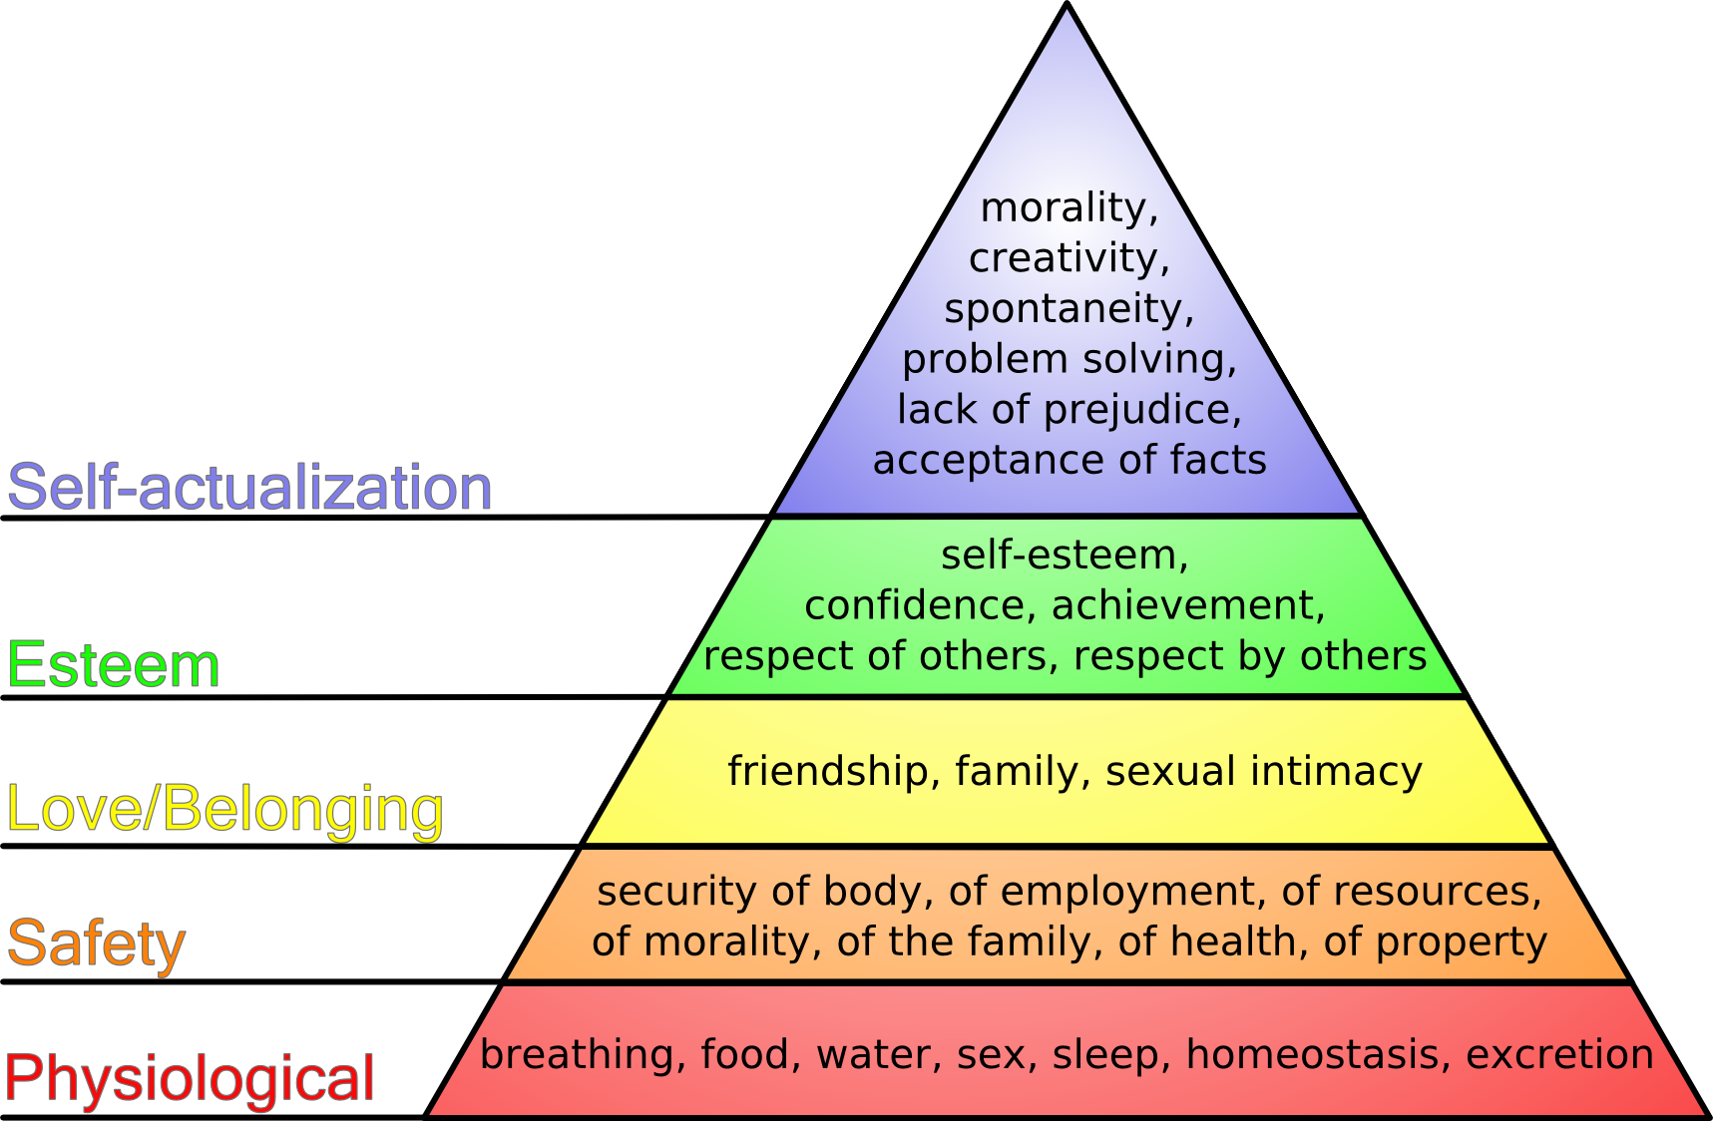
Maslow’s Hierarchy of Needs

Slide 30
Read & Discuss p29 Major Child Dev Theorists
Critical thinking p29
Which of the theorists were involved in
Personality formation?
Intellectual development?
Social development?

Slide 31
Applying Research
Read the following:
“Marta took care of her younger brother, Ramon, for two hours each day after school before her parents came home. Ramon had the habit of leaving his toys strewn about the family room when he had finished playing.”
How could Marta use Skinner’s ideas to get her brother to put his toys away when he was done playing?
What positive reinforcement could Marta give her brother to encourage him?

Slide 32
Activity
Divide into 2 teams.
Each team is to write 3 brief clues about each of the theorists in the chart on an index card.
Collect each team’s cards and place them in separate piles.
Put away notes and books.
A player form each team picks up a card from his or her team’s card pile and reads the clues to the other player. If the player from the other teams correctly identifies the theorist, his or her team gets one point. If the player misses, a player from the other team is asked to name the correct theorist. If they answer correctly that team gets a point. Continue until all cards are played.

Slide 33
Reading Check p28 teacher’s text
What are neurons?
What reinforces pathways in the brain?
What general rules of child development do researchers agree on?
Which child development theorist was the first to study children scientifically?

Slide 34
Influences on Development p 30
Development at Different rates due to:
Heredity
Environment
Heredity = biological transfer of certain characteristics from earlier generations. Often referred to as nature.

Slide 35
Influences on Development p 30
Environment=the people, places, and things that surround and influence person, family, home, school, and community. Nurture refers to influences and conditions in the environment.

Slide 36
Influences on Development p 30 Cont.
Development refers to the changes over time in a person’s structure, thought, or behaviors as a result of biological and environmental influences.
These changes are usually cumulative and progressive (build on one another to be more advanced).
How is the rate of development related to the safety of the child?

Slide 37
Influences on Development p 30 Cont.
Answer
Some children at age 3 or 4 may be able to use playground equipment independently. Others may not be able to do this.

Slide 38
Influences on Development p 30 Cont.
Parenting Guidelines
Research has revealed that the care a child receives has a great impact on the brain development. Guidelines from experts:
Be warm, loving, and responsive
Provide good nutrition
Talk, read, and sing to your child
Establish routines and rituals
Encourage safe exploration and play
Limit TV
Use discipline as an opportunity to teach
Recognize that each child is unique
Choose quality child care and stay involved with the care.

Slide 39
Activity
Divide into teams.
Use poster board to create a Venn diagram with 3 labels:
Heredity, Environment, Both (where the circle overlaps).
List on the diagram characteristic they believe are influenced by heredity and environment. If a characteristic is influenced by both, list in the overlapped portion.

Slide 40
Reading Check p30 teacher’s text
What are some early behaviors that occur for babies all over the world?
What is heredity?
What is environment?
What are some inherited characteristics you have from your parent’s?
Why aren’t siblings exactly alike?

Slide 41
Lifelong Growth and Development p32
Development continues beyond childhood from birth to death in stages called the human life cycle.
Each stage has challenges that must be met or skills won’t be acquired. These are called developmental tasks.

Slide 42
Development Beyond Childhood p32
Adolescence
Stage of life between childhood and adulthood
Teens work on 3 developmental tasks:
creating an identity
becoming independent
pursuing education and career opportunities

Slide 43
Young adulthood
Refers to people in their 20s when people finish school / training and start working.
People marry during this time.
The 30s
Establishing roots, evaluating life choices already made, and finding stability in careers and relationships

Slide 44
Middle age
Ages 40-55
Parents adjust as children become more independent.
Empty nest syndrome
Adults try to decide if they are happy with their life and make changes if not.
Late Adulthood
Ages 55-75
Most adults retire
Become more politically or socially active, travel, take, classes, or enjoy other activities they did not have time for previously.
Enjoy time with grandchildren
Health issues may arise

Slide 45
Very Late Adulthood
After age 75
Health problems more common
Need more assistance and care
If in good health, help out in society – boards, committees, etc.

Slide 46
Self – Esteem p 33
How Can We Help Children Dev Self-Esteem? Parents and others influence self-esteem.

Slide 47
Parents and others influence self-esteem.
Ways to have a (+) effect?
Give praise
Don’t be overly critical for every (-) you need 3 (+) to overcome this
Set realistic goals
Don’t set people up for failure by asking them to do things they aren’t ready to do.
Encourage new activities
Model self-esteem (be positive, confident)
Be honest about mistakes
Children need to see that adults make mistakes as well as how to react to them as well as solve them.

Slide 48
Brainstorm
What would someone with high self-esteem be like?
What would someone with low self-esteem be like?
Think of a time when someone’s criticism has damaged your self-esteem. Share if willing.
How is self-esteem going to affect the life of the child: home, school, work, community, raising their own child??

Slide 49
The Role of Self-Esteem in Development p35
Self-esteem or self-worth = value people place on themselves.
Plays a role in the ability to face and overcome the challenges of each developmental stage.
People with low self-esteem feel they are failing or constantly disappointing others.
There is a link between poor self-esteem, school performance, truancy, and criminal behavior.
Children who feel good about themselves are more likely to be enthusiastic for learning, form friendships and make healthy choices.
A sense of self worth can help children deal with life’s frustrations and disappointments.

Slide 50
Reading Check p30 teacher’s text
What do we call the developmental stages from birth to death?
What are developmental tasks?
Which stage presents the developmental task of creating identity?
What are some ways for a caregiver to encourage a child’s self-esteem?
Enrichment Activities
Additional child Development Theorists p9 – Research Child Theorist
Student Activity Manual
Study guide p8

Slide 51
Section 1-3
Observing and Interacting with Children p35
Objectives:
Explain why observation is important in the study of child development.
Compare subjective and objective interpretations.
Evaluate four methods of observation, and give examples of situations I which they might be used.
List specific guidelines to follow when observing young children.

Slide 52
Key Terms
Subjective
Objective
Running record
Anecdotal record
Frequency count
Baseline
Developmental checklist
Interpretation
Confidentiality

Slide 53
Why Observe Children p35
Can see children as individuals, meeting developmental challenges in their own ways and in their own time.
You will see how one stage leads to the next.
Ex: sitting up, pulling up, standing alone rolling over, crawling, walking
Will be able to help with the stages if you recognize them

Slide 54
Why Observe Children p35 cont.
Get to know the personality of the child so will be able choose activities suitable to their personality.
Can identify disabilities and special needs
If problems identified early, many can be resolved or improved
Provides feedback on what works and doesn’t work

Slide 55
How to Observe Young Children p36
Objective Versus Subjective Observations
When observing, separate fact from fiction.
What is objective and subjective?
Read p37 Figure 1-6

Slide 56
Types of Observations Records
Four ways are particularly useful:
Running Record
Write everything down for a certain period of time.
Good for getting to know children
Good for focusing on a certain area of development
Anecdotal Record
Like running record for there is no time limit

Slide 57
Types of Observations Records
3. Frequency Count
Tally of how often a certain behavior occurs
Useful when wanting to change an unwanted behavior
First, find a baseline = count made before any steps are taken to change the behavior.
As attempts are made to change the behavior, additional counts can be made. This will let you know what attempt is working and which isn’t.

Slide 58
Types of Observations Records
4. Developmental Checklist
A list of skills that should be mastered or behaviors they should exhibit at a certain age is a developmental checklist.
You check off the skills or behaviors that have been observed.
Record:
date and time,
number of children and adults present,
names and ages
setting – home, school, sitters etc
exactly where it occurred – jungle gym, class room desk, playing in living room, etc.

Slide 59
Reading Check p36 Teacher’s Text
Finish this comparison: Fact is to opinion as objective is to _________?
What is a problem with subjective observations?
What is a running record?

Slide 60
How to Act While Observing p39
2 ways to observe children:
Formal
Informal
Formal
Set up with permission to observe
Have details such as age
Informal
Can be in public places without permission
Estimate ages

Slide 61
Tips for both types:
You don’t want to be noticed, try to blend in with the environment.
Avoid calling attention to yourself
Try to sit or stand slightly outside the area where the children are
Be ready to take notes
Be sure you understand the observation assignment before you begin.
If the children come to you and want to know what you are doing, tell them you are writing a story about how children play and will write about them, if they go play.
If it is an observation where you are directly involved with a child, pull them aside to do the observation.

Slide 62
Reading Check p38 teacher’s text
Which method of observation is best used if you are trying to change an unwanted behavior?
What’s the difference between a formal and informal observation?
Why is it important that you try not to be noticed while observing?

Slide 63
Using Observations p41
Finalize your notes or write a summary. Be sure it is neat and professional as it may be used for future reference and others may see it.
Interpretation
This is the analysis that will include your ideas and opinions.

Slide 64
Confidentiality
Protect the child’s and the family’s privacy. Do not share with anyone other than parents if you are in a daycare situation. For at school, only the daycare providers, your instructor, parents and our class may know what our observations are.

Slide 65
Observation cd

Slide 66
Activity – Observation
Divide into groups.
Each group determines a different purpose for observing a child or children.
All groups will observe the same child or children and answer 2 questions:
What was the purpose of your observation?
What did you learn from your observation?
**If while observing you see a child that is about to do something harmful or dangerous to themselves or someone else, stop observing and intervene. This may mean taking action yourself or getting help.
For ex: a child starting to put a small object in their mouth.

Slide 67
Brainstorm – When might you have to stop observing and get help?
Most of our observations are brief so may not be accurate. The longer we observe the more we will know. For ex: a child may appear like a brat or spoiled but we may not know that something happened at home or earlier in the day to cause the behavior.

Slide 68
Reading Check p40 Teacher’s Text
What kinds of notes should you take before your observation?
How is interpretation different from recording your observation?

Slide 69
Student Activity Manual
Describing Development p14
Do together as class activity.
Student Activity Manual
Study Guide p11

Slide 70
****Assignment
Making Connections p45
Imagine you are campaigning to prevent children from being put to work. Write a letter to the editor of a newspaper arguing against child labor. Use your child development information to support your arguments. Write as though you are wanting to enact a policy/law to prevent this.
Test Chpt 1

