Slide 1
Chapter 7
Physical Development
Of
Infants

Slide 2
Section 1: Infant Growth and Development.
Objectives: development follows.
Explain the effects that heredity, nutrition, health, experiences, and environment have on an infant’s growth and development.
Describe how a typical baby gross in the first year.
Classify the different movements a baby makes as reflexes gross motor skills, or find motor skills.

Slide 3
Section 1 Infant Growth and Development.
Terms
Developmental milestones
Stimulating environment
Growth Chart
Proportion
Depth Perception
Reflexes
Gross motor Skills
Fine Motor Skills
Hand-eye Coordination

Slide 4
Growth = change in size such as weight and length
Development = increases and changes in physical, emotional, social, intellectual skills.

Slide 5
Infants physical development follows 3 basic patterns:
Head to foot
Near to far
Simple to complex

Slide 6
Infants physical development follows 3 basic patterns: Cont.
Head to Foot
Begins before birth
Continues after birth:
1st raises head to see
2nd arms and hands
3rd legs and feet
4th walking

Slide 7
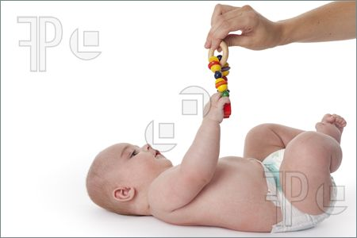
Infants physical development follows 3 basic patterns: Cont.
Near to Far
Starts close to the trunk of the body and works outward
1st wave arms
2nd reach
3rd grasp

Slide 8
Infants physical development follows 3 basic patterns: Cont.
Simple to Complex
Simple - Large muscle groups (legs, neck, arms, torso)
Control head, rolling, reaching, crawling
Complex - Small muscles
Coloring,

Slide 9
Developmental Milestones
=Skills and abilities a child accomplishes at certain ages: walking, climbing
Varies due to:
Heredity
Nutrition
Health
Experiences
Environment

Slide 10
Developmental Milestones Cont.
Environment Cont.
No encouragement
No opportunity
Stimulating Environment – variety of things to see, taste, smell, hear, touch
Stimulating Environment enhances brain development
Lack of stimulation slows or delays development
2nd Hand Smoke causes poor health, respiratory, ear infections, and asthma which hinder development.

Slide 11
Growth in 1st Year
Growth charts just show an average weight, height/length
Fast growth period
Weight
Loses 10% of birth weight in first 5 days
Gains it and more very quickly (1-2 lbs /mo)
Triples by age 1
Length
Increases by 50% in 1st yea

Slide 12
Discussion
How does a country’s economy affect the growth rates of children?
What environmental or societal factors do you think affect growth rate most?

Slide 13
Growth in 1st Year Cont.
Body Shape
Curled position = fetal position
Curved legs and feet curve inward
Elongated head due to birth canal
Skinny arms and legs
Large abdomen
Umbilical cord dries in about 3 weeks
The baby straightens out in about 6 months
Chubby by 3 months

Slide 14
Growth in 1st Year Cont.
Proportion
=size relationship between parts of the body
Head and abdomen are large compared to the rest
Head grows fast to accommodate the brain (more than ½ of the total head growth occurs)

Slide 15
Growth in 1st Year Cont.
Vision
Follow movement
Blurry but clears in about a week on objects 7-10” away
At 1 month focuses on objects 3’ away
At first it is 2 dimensional (like looking at a picture)
At 2 months it is 3 dimensional (depth perception)
At 6 months clarity and sharpness of adults

Slide 16
Growth in 1st Year Cont.
Hearing
Develops before birth
Responds to sounds – heart rate may change and they may move
At birth – can tell the direction the sound came form
Respond to tone rather than words
Soothing voice – calms
Angry voice – alarms
7 months – recognize parents voice
Hearing helps language development –
Imitate what they hear
Preemies and babies with ear infections may have delayed language

Slide 17
Growth in 1st Year Cont.
Touch (newborns)
Rely on touch of others to teach them about the environment
Don’t have enough brain development to explore
Use touch to explore as they learn to reach and grasp

Slide 18
Growth in 1st Year Cont.
Smell
Smell doesn’t dev until birth due to being in amniotic fluid
Some can smell within 10 days –
know their parent’s scents

Slide 19
Growth in 1st Year Cont.
Taste
At 2 weeks, can taste difference between water, sour, sugar, salt, milk
At 2 weeks shows preferences in the liquids
Put things in mouth to learn about environment
If something can fit into a paper towel tube, it is too small for a baby to have

Slide 20
Growth in 1st Year Cont.
Voice
Shrill cry at first but softens as lungs mature
The voice sound is also affected by growth of
throat muscles
tongue
lips
teeth
vocal cords
Tongue changes shape making speech possible

Slide 21
Growth in 1st Year Cont.
Motor Skills
At birth movement is due to reflexes = instinctive automatic responses
In the first year, the motor skills are developing
Gross Motor = large muscles
Fine Motor = small muscles

Slide 22
Growth in 1st Year Cont
Gross Motor Skills
Legs, arms, trunk, and neck
Fine Motor Skills
Fingers, hands,
Hand-Eye Coordination
=ability to move hands and eyes precisely in relation to what is seen
By 3 – 4 months reach and grab for objects
By age 1, pick up objects and put in another place

Slide 23
Reflexes
Reflexes p219
http://pregnancy.about.com/cs/newborns/a/aa061801a.htm
The reflexes he or she is born with help transition them to life and learn what they need to survive.
Here are some of these reflexes to help you get to know your baby better:

Slide 24
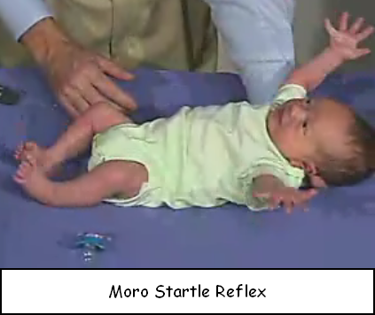
Reflexes Cont.
Moro or Startle Reflex:
When you fail to support or hold the neck and head, the arms of your baby will thrust outward and then seem to embrace them selves as their fingers curl.
This reflex disappears
at about 2 months of age.

Slide 25
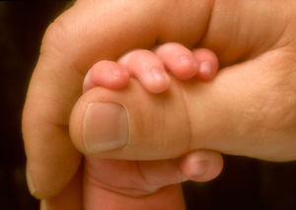
Reflexes Cont.
Palmar Grasp:
When you touch the palm of your baby's hand, the fingers will curl around and cling to your finger or an object.
This reflex makes it difficult to obtain handprints until it
disappears at about
6 months.

Slide 26
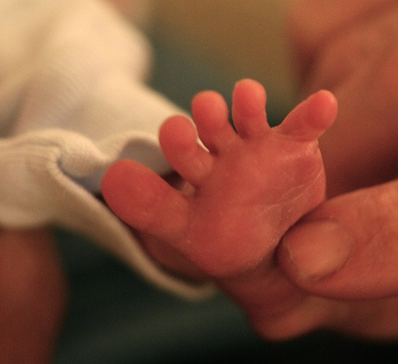
Reflexes Cont.
Babinski or Plantar Grasp:
This reflex occurs when you stroke the sole of your baby's foot, his toes will spread open and the foot will turn slightly inward.
Disappears by the
end of the first year.

Slide 27
Reflexes Cont.
Sucking:
While you may not believe this to be reflexive, it is.
Ensures that the baby will nurse on a breast or bottle to be fed and occurs when something is placed in the baby's mouth.
It is slowly replaced by voluntary sucking around 2 months of age.

Slide 28
Reflexes Cont.
Rooting Reflex:
When you stroke your baby's cheek she will turn towards you, usually looking for food.
This is very useful when learning to breastfeed your baby.
Gone by about 4 months.
May also occur when the baby accidentally brushes her own face with her hands.
It can sometimes be a source of frustration if your baby flails her arms during feedings. Simply using a blanket to pin her arms closer to her body during feeding may help.

Slide 29
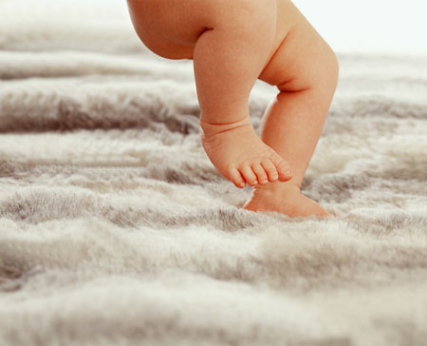
Reflexes Cont.
Stepping Reflex:
If you take your baby and place his feet on a flat surface he will "walk" by placing one foot in front of the other.
This isn't really walking and
will disappear by about
4 months of age.

Slide 30
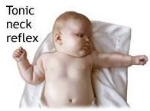
Reflexes Cont.
Tonic Neck Reflex:
This is also called the fencing reflex, due to the position.
When you lay your baby on her back and her head turns to one side she will extend her arm and leg on that side while the opposite arm and leg bend, assuming a "fencing" position.
This reflex is present only
until about the 4th month.

Slide 31
Reflexes Cont.
Swimming:
If you were to put a baby under six months of age in water, they would move their arms and legs while holding their breath. This is why some families believe in swim training for very little babies. It is not recommended for you to test this reflex at home for obvious safety reasons.
Your baby will have his or her reflexes tested shortly after birth. Absence or weak reflexes can be caused by birth trauma, medications used, illness, etc. Talk to your pediatrician if you have concerns about your baby reflexes or ask them to show you during a newborn exam the amazing feats of your new baby.

Slide 32
Assignment
Answer Questions

Slide 33
Section 2 Infant Care Skills p225
Objectives:
Demonstrate how to safely handle a baby.
Evaluate various ways of nurturing and bonding with babies while caring for them.
Identify tow possible sleep hazards.
Identify a baby’s nutritional needs as well as foods to avoid
Compare the benefits of breast milk and formula
Describe the best type of clothing suitable for a baby.

Slide 34
Section 2 Infant Care Skills p225
Terms
Antibodies
Malnutrition
Shaken baby syndrome
Weaning

Slide 35
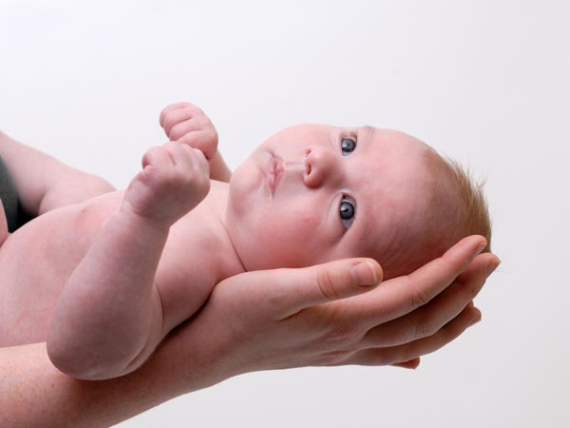
Handling Babies
Handling Babies see figure 7-10 p226
Support head as neck muscles aren’t dev’d
By 4 months they can hold their head up without support but still need gentle handling
Holding them close makes them feel secure
Move slowly and gently when picking up and laying down

Slide 36
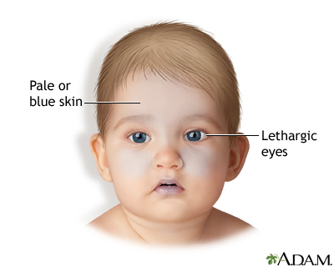
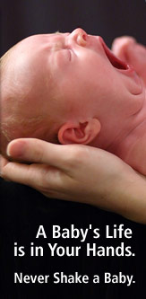
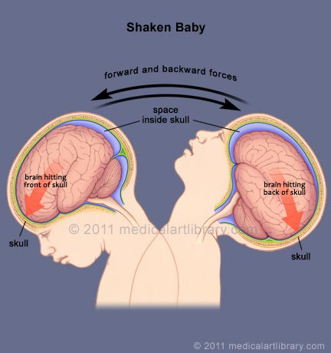
Shaken Baby Syndrome p226
Damages the brain, retardations, cerebral palsy, blindness, broken bones injuries to the neck and spine, death

Slide 37
Crying Babies
What if the baby is ok but won’t quit crying and you are at your wit’s end?
Put baby down in safe place and go to another room, breathe deep, find a way to calm yourself
Get help from a friend or family member
Call someone and talk to them about the problem
Call a parenting hotline or take the baby to a crisis nursery
Brainstorm
What should you do if a baby cries and cries?

Slide 38
Crying Babies Cont.
Responding to Cries
Be sure they are clean, well fed, the right temp, not in pain, comfortable, safe, not scared, etc.
Try rocking, talking, singing, music, heart beats, white noise, swings, strollers, toys, rubbing the baby’s back,
Different theories
Some say you can spoil a baby by picking it up and holding it every time it cries.
Some say you can’t.

Slide 39
Sleeping
Adequate Sleep
Needed for growth and development as chemicals release that help growth
Cells build and repair themselves
Needed for the brain to work properly
Precautions when putting a baby to sleep.
Safe bed
No fluffy pillows, blankets, bumper pads, toys
Be careful there is nothing they can get tangled up in
Look at their clothing – will the gown work up around their neck
Place face up to reduce chances of SIDS

Slide 40
Sleeping Cont.
Bedtime Routines
Warm bath
Reading or singing
Rocking
Pat them when you put them down and leave room
Let them whimper or cry – soon they usually get used to the routine and stop this.
Some say if they don’t quit crying soon, go back, pick then up, soothe them, put them down, leave again.
Hopefully they won’t cry or will cry a shorter time each time you do this.
Doing this will let them know someone will always be there.

Slide 41
SIDS
= Unexpected death of an infant with no apparent cause
Occurs during sleep
No crying
No struggle
Affects infants up to 12 moths old but the majority are under 6 months old
Strikes 1 or 2 out of every 1000
Most often occurs in winter
Cause is uk – suspect suffocation
Groups at risk:
Male babies with a low birth weight
Premature babies
Babies who live with a person who smokes
Babies who sleep on their stomachs

Slide 42
Sleep Patterns
Sleep Patterns Newborns sleep 12 – 20 hrs / day. Sleep decreases during the first year

Slide 43
Newborns
16 hrs / day
4-5 naps / day (each about 3-4 hrs)
Awake for a few hours between each nap

Slide 44
3 Months
14-15 hrs / day
Total amount decreases but takes longer naps – about 4-5 hours long
Longer sleeping periods at night

Slide 45
4 Months
12-14 hours
Takes naps midmorning and late afternoon
Sleeps much of the night

Slide 46
6 months
12-14 hours / day
Takes 2 long naps
Sleeps about 6 hrs / night

Slide 47
1 Year
12 hours / day
May take 1 -2 naps
Has 9-10 hours sleeping periods at night

Slide 48
Feeding p230
Nutrition
In the first 6 months, all nutrition can be gained from breast milk or formula.
If you use formula, use iron fortified
Around 6 months, start solid foods.
Start in this order:
Cereals
Fruits
Vegetables
Cooked meats
At about 8 months, half their calories should come from solid foods
Keep gradually increasing the solid foods

Slide 49
Feeding p230
If under age 1, don’t feed them cow’s milk as it is hard to digest, lacks nutrients that breast milk and formula have.
Limit fruit juice
Causes tooth decay
Can make bottoms sore
Lacks nutrients that breast milk and formula have
Curbs appetite
Wait until about 6 months old for juice

Slide 50
Feeding p230
Breast-Feeding
Contains all nutrients needed
Has antibodies
Germ free
Easy to digest
Get fewer ear infections, respiratory infections, and allergies than bottle-fed babies
Less likely to dev asthma
Lacks Vit D for bone growth but the skin makes it when exposed to sunlight

Slide 51
Feeding p230
Formula
Made to meet the needs of babies
Contains modified cow’s milk so easier to digest
Soy formula also available
3 forms:
Ready to use
Concentrated liquid that is mixed with water
Powder that is mixed with water

Slide 52
Feeding p230
Schedules p231
Frequent feedings needed as can only hold a small amount at one time
First few weeks
Breast fed babies eat 8-12 times/day or more
Formula fed babies eat every 3-4 hrs
By 2nd or 3rd month they are on a regular schedule – may wake every 3-4 hrs
When a baby reaches about 12 lbs they don’t need late night feedings. They can hold enough to last them all night.

Slide 53
Feeding p230
Feeding Methods p232
Breast Feeding
Bottle Feeding
Burping
Burp twice during ea feeding
Look at p234 for directions

Slide 54
Weaning p235
=changing from bottle / breast to a cup
Do around age 1
Readiness Signs:
Not interested in the bottle / breast
Playing or looking around while feeding
Pushing the bottle / breast away
Showing a preference for eating from a spoon
Do gradually – let them have a slow transition so they get used to drinking milk or formula
Begin with sips
Gradually increase the amount in the cup
Gradually decrease the amount in the bottle
Slowly omit bottle or breast
Forced weaning may result in behavior problems

Slide 55
Solid Foods
Introducing p235
Start around 6 months (google latest medical opinions and consequences)
Once they eat cereal they can start other foods
Watch for reactions
Rash
Digestive problems
Allergic reactions
Introduce new foods at least 4 days apart

Slide 56
Feeding Cont.
Self-Feeding
Start when they can sit up in a high chair – around 8-10 months
Start with finger foods and gradually use a spoon
Try: small pieces of toast, cereal pieces, small pieces of chicken, small pieces of pasta, small pieces of banana

Slide 57
Nutrition
Nutritional Concerns p237
Well balanced meals
Let them eat whenever hungry
Soft, easy to gum foods that can be swallowed easily

Slide 58
Nutrition Cont.
Malnutrition = inadequate nutrition
Poor brain development, learning difficulties, physical development impaired
Poor eating habits in the first year can lead to problems later
Allergies
=oversensitivity to a particular substance
The immune system attacks the substance and allergy symptoms are the side effect

Slide 59
Allergies Cont.
Anaphylactic Shock=life threatening conditions that makes it difficult to breathe
Not all allergies cause this
Signs of food allergies
Excessive fussiness
Vomiting almost all food after feeding or eight to 10 watery stools a day
Children often outgrow allergies to eggs, milk, soy but other allergies may last a lifetime
Best treatment – avoid the food
Breast feeding mothers should also avoid the food

Slide 60
Dressing
Babies lose more heat then adults
Sensitive to overheating
Dress in layers
Comfortable
Newborns sleep a lot so don’t need much
When crawling – wear something that allows movement
Shoes aren’t needed until they walk
Read p238
Pullover stretchable fabric
Open-front shirts
One-piece with feet

Slide 61
Section 3: Infant Health and Wellness
Objectives:
Demonstrate how to bathe a baby
Demonstrate how to diaper a baby.
Describe the signs of teething
Describe at least five important ways to keep a baby safe at home.
Explain why checkups and immunizations are important for babies.

Slide 62
Section 3 Infant Health and Wellness Cont.
Key Terms
Cradle cap
Diaper rash
Teething
Immunizations
Vaccine

Slide 63
Bathing p241
2 types
Sponge bath till navel heals – about 2 weeks
Tub bath after that – can use a tub, sink, dishpan
Best to wait until they can sit up before using a full size bath tub
2-3 months old should be bathed 2 or 3 times / week
Increase the number of times / week with activity and age
How to bathe a baby
Prepare
Get everything you need ready and set up.
2 inches of warm water – test on your arm
Undress baby

Slide 64
Bathing Cont.
Put baby in tub
Support head and neck with one hand and arm
Hold body with the other hand
Lower into tub, feet first - slowly
Hold continually
Stay with baby at all times.
Use clear water and soft cloth

Slide 65
Bathing Cont.
Wash face and hair
Wet hair, add shampoo, rub gently
Rinse by pouring water toward the sides and back (can use shampoo visors)
Wash body
Pat dry, wrap with towel immediately
Diaper right away – You know what cold temps can cause ????
Bathe about twice / week

Slide 66
Cradle Cap and Nails
Cradle Cap=skin condition known for yellowish, crusty patches on the scalp.
Disappear after a few weeks or months
Treat by washing scalp daily with mild shampoo
Baby oil or excessive shampooing can worsen the scales or dry the skin
Nails - Trim baby’s nails at bath time with baby clippers

Slide 67
Diapering p243
Diapering
Diapers may need changed 12-15 times/day
Newborns wet several times / hour but in small amounts that don’t need changing each time (may not even notice it)
Older babies need changed less often and notice when they are wet

Slide 68
Diapering How To
Have a special changing area with all the supplies
Flat clean surface
Wipes
Soft tissues
Lotion /oil / ointment
Diapers
Dry cloths

Slide 69
Diapering How To
Remove and clean with moist cloth or disposable wipe
Put on fresh diaper
Hold ankles and lift the body to slide the diaper underneath baby
For cloth diapers, the folded side goes in the back for girls and in front for boys
Bring diaper up between legs
Fasten with tape or pins
If using pins, keep fingers between the diaper and the baby’s skin
If using cloth diapers, put on plastic pants / waterproof pants etc

Slide 70
Diaper Rash
Diaper Rash=patches of rough, irritated skin, sometimes painful raw spots
Prevent
Control bacteria in diaper by changing more often
Thoroughly clean the area at changing time
Treat with ointment if needed
Expose to air
Avoid waterproof pants

Slide 71
Types of Diapers
Disposable Diapers
More convenient
More effective at keeping babies dry and comfy
May dev sensitivity to them – rashes
Add to environmental problems
Cloth Diapers
Economical if washed at home
Not economical if you use a laundry service
Environmental friendly

Slide 72
Disposing of Supplies
Dispose of used supplies
Have a diaper pail or trash can with lid
Never flush down the toilet
Rinse dirty cloth diapers in the stool; then soak in a covered container of water, detergent, and bleach
Wash cloth diapers in hot water with mild detergent

Slide 73
Teeth
Baby’s Teeth p244
Development begins 6th week of pregnancy
Teeth usually break through at about 6 months
Primary teeth or baby teeth are usually in by age 12 months

Slide 74
Teething
=process of the teeth pushing through the gums
Symptoms
Gums swell and are tender and painful
Cranky / fussy
Drool a lot
Low-grade fever (some spike higher)
Want to chew on something hard and cool

Slide 75
Teething Cont.
Treatment
Massaging gums
Teething rings
Cold, wet wash cloth
Medications – docs disagree with each other on this
Clean teeth regularly with soft moist cloth or gentle brush
Can get fluoride after 6 months old

Slide 76
Health and Safety Concerns p245
Choking
Keep small objects out of reach and off floor
Suffocation
Careful with soft, flexible objects
Keep plastic bags / balloons away
Keep soft animals out of crib
Water
Never leave alone in tub or with play water in a bucket or pool
Falls
Don’t leave unattended on raised areas – beds, changing tables,
Poisoning
Keep all medicines, cleaners, paints, poisonous substances locked

Slide 77
Health and Safety Concerns p245
Never leave alone around hot liquids, ovens, irons, curling irons,
Use safety covers on electrical outlets
Keep water heater set no higher than 120 F
Sun
Sunglasses and hats with brims
Avoiding sun exposure
Dress in lightweight long pants and long-sleeved shirts
Sunscreen
Animals
Never leave alone with animals
Clothing
Flame retardant – check label

Slide 78
Health and Safety Concerns p245
Regular Checkups p246
1 mo, 2 mos, 4 mos, 6 mos, 9 mos, 12 mos
Track growth and dev, answer concerns
Immunizations p246
=shots giving small amt of disease carrying germs to the body is able to build a resistance to the disease
Vaccine = injection with the germs
Required for school

Slide 79
Health and Safety Concerns p245
Signs of illness
Irritability Diarrhea
Lack of energy Rashes
Constipation Vomiting
Nasal congestion, Fever
Persistent cough
Chpt test

