Slide 1
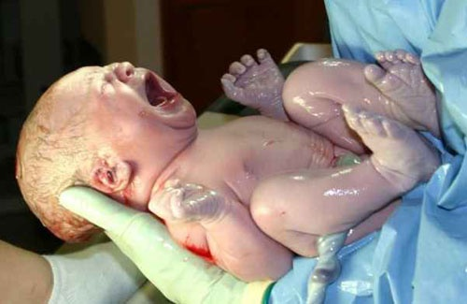
Baby’s Arrival
Chpt 6 p178

Slide 2
Section 6-1 Labor and Birth
Objectives:
Describe signs that indicate labor may have begun.
Contrast false labor and premature labor.
Summarize the 3 stages of labor.
Explain what happens during cesarean birth
List what factors can contribute to a premature birth.

Slide 3
Section 6-1 Labor and Birth
Terms:
Cervix
Contractions
Fetal Monitoring
Dilate
Cord Blood
Stem Cells
Cesarean Birth
Incubator

Slide 4
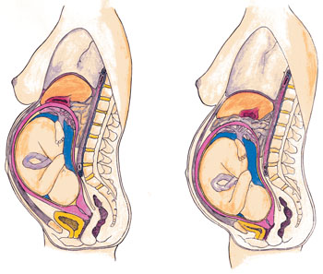
Beginning of Labor p179
Lightening = occurs when the baby settles deep in the pelvis near the time of birth
  Pressure on the upper abdomen is reduced
  “dropped”
  Occurs days or weeks before labor – 1st pregnancy
  Occurs just before labor – 2nd + pregnancy

Slide 5
Early Signs of Labor
Show or Bloody Show = few drops of blood or pinkish vaginal stain that occurs when the mucus plug at the uterus dissolves.
  May occur a few days before birth
  Mucus plug seals the cervix and prevents bacteria from moving into the uterus
  Cervix = lower part of the uterus

Slide 6
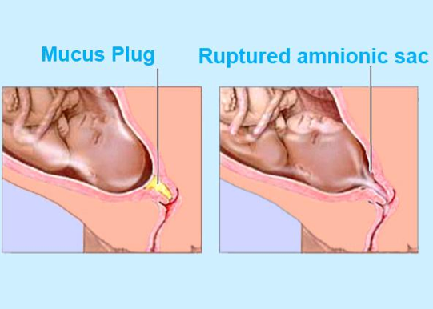
Early Signs of Labor Cont.
Water breaks
  Amniotic sac breaks
  May be a trickle or gush
  Occurs immediately before birth - 24 to 48 hrs – get to hospital
  Need to get to doc to prevent baby from getting infection
  Note time, color and odor of fluid, call doc

Slide 7
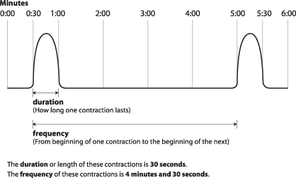
Early Signs of Labor Cont.
Contractions = tightening and releasing of the muscles of the uterus
  When the uterus contracts, it shortens and closes, pushing the fetus against the cervix; then relaxes
  As you get closer to delivery the relaxing time is shorter
  After the birth of the baby the placenta is expelled by a contraction

Slide 8
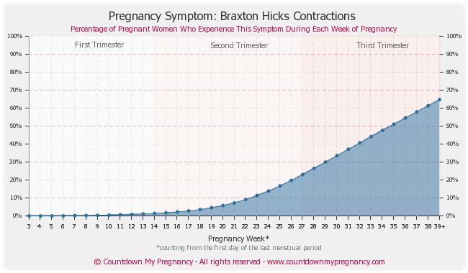
Braxton Hicks Contractions
Practice contractions
  Not real labor
  Can occur in 2nd trimester but usually in the 3rd
  Factors that seem related to these =activity and dehydration
  If they go away after moving around, they are probably

Slide 9
Fetal Monitoring
Watching the baby’s heart rate for indicators of stress is done during labor and birth.
Ultra sound
Fetoscopes = stethoscopes use to monitor the heart rate for short periods of time
Internal Fetal Monitoring - electrode placed on the head of the fetus after the mother’s water has broken.
Telemetry monitoring- uses radio waves to monitor the heartbeat. The mother wears a transmitter that sends the heartbeat to the nurse’s station.

Slide 10
Premature Labor
40 weeks = full term
  Ok if a week early or week late
37 weeks or less =premature
  Warning signs:
    Contractions every 10 min
    Dull backache
    Leaking fluid or blood
Medication can stop labor

Slide 11
False Labor p181
Hours or even days before actual labor
Strong contractions and think they are in labor
3 signs that indicate false labor:
  Contractions are regular or rhythmic
  Contractions don’t become stronger over time
  Contractions end with light exercise such as walking

Slide 12
Inducing Labor p181
Can be done with medication or puncture the amniotic sac
Done for medical reasons or in emergencies
If in the womb after 42 weeks, they may induce

Slide 13
Stages of Labor p184 see Figure 6-3 p182-183
3 stages:
1st Contractions open the cervix
2nd Baby is Born
3rd Placenta Expelled

Slide 14
Stages of Labor p184 see Figure 6-3 p182-183
Stage 1
Contractions pull up on uterus, softening and thinning it so it will open easier.
Contractions get stronger lasting about 60 secs and 5-6 min apart
After the cervix open or dilates, the baby moves to the lower pelvis – usually head first.
Breech Presentation = feet first
By the end of this stage:
  Uterus fully dilates to 10 cm
  Strong contractions last 90 seconds and are 2-3 minutes apart
Pushing during this stage can cause tearing or injuries

Slide 15
Stages of Labor p184 see Figure 6-3 p182-183
Stage 2
Contractions – more productive, pushing baby through he pelvis and out the vagina or birth canal
Safe to push during this stage
Relaxin =hormone released to help tissue stretch moving apart the pelvic bones and stretching the vaginal walls

Slide 16
Stages of Labor p184 see Figure 6-3 p182-183
Baby’s body designed for birth
Soft skull with 5 separate bones that move so it will fit through the pelvis and vagina
Episiotomy = cut at the lower edge of the vagina so the baby will go through without tearing the skin.
Forceps = surgical tongs used to grip and move or pull the baby
Vacuum Extractor = suction to the baby’s head to move or pull it.

Slide 17
Stages of Labor p184 see Figure 6-3 p182-183
Stage 3
Placenta expelled with contractions
Cord Blood = blood left behind in the umbilical cord and placenta contains stem cells.
Stem Cells =capable of producing all types of blood cells.
Used to treat many serious blood-related illnesses in the baby’s and other family members.
Can store the blood for later use
Can donate blood

Slide 18
Cesarean Birth p187
Small incision in abdomen
Reasons for c-section:
  Lack of normal progress during labor
  Baby in wrong position
  Multiple babies
Can be awake during c-section
Father and others can be present

Slide 19
Premature Birth p188
5-6% of all babies born prematurely
37 weeks or under
Less than 5 lbs 8 oz
Require special care
  Systems for controlling body temp, breathing, and feeding aren’t mature
  Brain not developed to control the above
Incubator = enclosed crib where oxygen, temperature and humidity is controlled.

Slide 20
Do Review Questions p189 #1-11

Slide 21
Section 6-2 The Newborn p190
Objectives:
Describe the newborn’s appearance immediately after birth.
Identify the physical changes that prepare the newborn for life outside the uterus.
Explain the purpose of common hospital procedures following birth.

Slide 22
Section 6-2 The Newborn p190
Terms
Fontanel
Lanugo
Vernix
Apgar Scale

Slide 23
Arrival
During pregnancy the lungs are collapsed - oxygen comes from the mother’s blood.
During delivery, the lungs fill with amniotic fluid that was in its trachea.
  Most gets squeezed out during the trip through the birth canal.
The remaining fluid is suctioned out immediately after birth
If the baby doesn’t breathe normally, medical personnel rub the baby’s back

Slide 24
Arrival Cont.
Once the lungs begin to work, blood circulated to and from the lungs rather than bypassing them like before.
Within a few minutes of birth the cord stops pulsing with the mother’s heartbeat and begins to shrink
The cord is clamped and cut off leaving a small stump at the baby’s navel which falls off in a few days.

Slide 25
How Does the Newborn Look? P191
Head
Wobbly head that looks too large
Skull may appear pointed or lopsided
Skull bones not fully fused
Fontanels = open spaces can be found on the head and are not yet joined
  One is just above the forehead
  One is toward the back of the skull
  Allow the bones to move together during birth

Slide 26
How Does the Newborn Look? P191
Head Cont.
  Thick layer of skin covers them for protection till they grow together
  Grow together in the first year and half
Baby’s head is about ¼ of the total height which averages 20”
Nearly twice the size compared to other body parts
Large because the brain is large
Brain and head grow less than the rest of the body after birth

Slide 27
How Does the Newborn Look? P191
Face
Swollen /puffy
Fat Cheeks
Short flat noses
Receding chins
Small features make it easier to nurse
Eyes are nearly adult size

Slide 28
How Does the Newborn Look? P191
Face Cont.
African, Asian, and Hispanic – brown eyes and stay brown
Caucasian – dark grayish-blue at birth, but may change in 3-6 months
Milia=tiny white bumps on their nose and cheeks.
  Baby acne
  Plugged oil ducts caused by stimulation from the mother’s hormone, which remain in the baby’s system for a short time after delivery
  Disappear in a week or so.

Slide 29
How Does the Newborn Look? P191
Fingers & Toes
Cool because circulatory system not yet working well
Keep wrapped
Other
Lanugo – downy hair on foreheads, backs, and shoulders.
Usually on preemies
Disappears soon

Slide 30
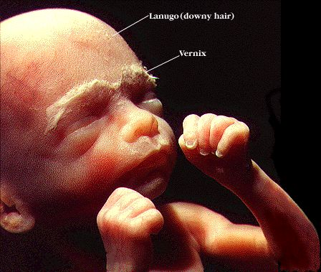
How Does the Newborn Look? P191
Vernix=thick, white, pasty substance
Made of the fetus’s shed skin cells
and the secretions of skin glands
Protects again constant exposure
to the fluid
Washed off during the
first bath

Slide 31
Testing the Newborn p193
Apgar Scale = system of rating the physical condition of the newborn baby
5 Factors Checked at 1 minute and again in 5 minutes after birth and are rated from 0 to 2
  Heart Rate
  Breathing
  Muscle Tone
  Response to Stimulation
  Clear Skin Color
Normal Score = 6 to 10 range with 10 being perfect
Lower score indicated that the baby may need medical assistance

Slide 32
Testing the Newborn p193
Also at birth:
Weigh
Measure
Apply antibiotic ointment to the eyes to prevent infection (silver nitrate)
Injections of vitamin K may be given to prevent hemophilia
Foot printed
Blood typed with cord blood

Slide 33
Section 6-3 The Postnatal Period p195
Objectives:
Explain what bonding is and how to promote it.
Identify problems that often accompany prematurity.
Summarize the physical and emotional

Slide 34
Section 6-3 The Postnatal Period p195
Terms
Bonding
Colostrum
Neonatal period
Jaundice
Bilirubin
Lactation consultant
Rooming-in
Postnatal period
Postpartum depression

Slide 35
Bonding
Bonding = forming emotional ties between parents and child.
Found to be very important in recent years.
Connects with parents
Develops connections within the brain

Slide 36
Bonding
To aid with bonding:
Delay some tests till after the mother holds the baby (if baby ok)
Place baby on mother’s abdomen to feel warmth of her skin and hear her voice and heartbeat.
Parents begin immediately touching and feeling the baby.
Parents also look into the eyes of the baby and newborn focuses on their face.
Feeding baby
Have baby stay in room with mother
Father in delivery room

Slide 37
Colostrum=high-calorie, high-protein early breast milk
Neonatal Period = first month after birth
Jaundice = Liver can’t remove bilirubin so the baby’s skin and eyes look slightly yellow.
Occurs in over 50% of the babies
Left untreated it can damage the nervous system

Slide 38
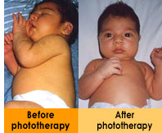
Bilirubin = substance produced by the breakdown of red blood cells
The baby may be producing too much or the liver may not be able to remove it fast enough
Phototherapy = use of ultraviolet light to treat jaundice

Slide 39
Feeding p198
Babies lose weight during first few days of life but gain it back later.
By day 3 or 4, breast-feeding mothers begin producing more milk.

Slide 40
Feeding
Lactation Consultants = professional breast
Show mothers how to encourage adequate milk
How to position babies properly so that they can nurse
During the first few days, babies may be too sleepy to eat. Unwrap them to expose them to the air in the room. It provides enough stimulation to wake them.

Slide 41
Rooming-In p198
Baby remains with the mother the entire hospital stay.
Advantages: one main caregiver so they usually cry less and mother gets more rest. Parents learn how to care for them quicker.
Partial rooming-in = baby stays in the nursery part of the time.

Slide 42
Legal Documents p198
Birth certificate form completed and is sent to the gov’t office
Social Security # - get one in the first year. Hosptial may give you a form.

Slide 43
Premature Babies
Most stay in a NICU (neonatal intensive-care unit)
Stay till internal organs develop and function independently
Tube fed because lack ability coordinate ability to suck and swallow
Breathing machine if lungs aren’t mature

Slide 44
Premature Babies
Increased risks:
Developmental delays
Cerebral palsy
Respiratory distress syndrome
Transient tachypnea
Pneumonia
Bradycardia
Apnea
Anemia
Sepsis

Slide 45
Premature Babies
Preemies go home when:
Able to breathe on own
Drink
Maintain a steady body temp
Maintain a weight of 5 or more pounds
The more premature the baby is, the more risks they face

Slide 46
Assignment
Complications Premature Babies Face
Find out what your assigned term means and share with class.

Slide 47
Postnatal Care of the Mother
Postnatal Period = after birth of child
Physical Needs
Rest
Sleep interrupted by hormonal changes and feedings)
Exercise
Stretching and walking short distances help lose weight and feel more energetic.
Good nutrition
Breast-feeding mothers are hungrier and need 300 more calories/day and need to drink more
Medical checkups
4 to 6 weeks have a postnatal checkup

Slide 48
Emotional Needs
Confusion a few days after birth
Mood swings
“Baby Blues” are common
  Cry for no reason
  Feel irritable, lonely, anxious, or sad
Postpartum Depression =blues don’t go away.
Sad or crying a lot, no energy, being overly anxious, little interest in the baby, and thinking of causing harm.

